Slide 1
Oregon Resource Allocation Advisory Committee
Advisory Committee Meeting
February 28, 2023

Slide 2
Interpretation
Click the globe to enable interpretation options.
Select the language.
You can choose to hear the original audio at a lower volume or select “mute original audio” to stop hearing the original audio.

Slide 3
Meeting Resources
If you need support, we have:
Simultaneous Spanish language interpretation
Technology support
Note taker
If you have a need, contact Lisa Bui at: 503-576-9321
Please note that this meeting will be open to the PUBLIC
1. The general public may be in attendance
2. The meeting summary will be posted to OHA’s website
Notes:
Lisa can be main point of contact to triage needs and connect folks to the right person during the meeting
Let committee know that anything entered into the chat is subject to disclosure under public records law

Slide 4
Purpose
Share updates on the Triage Approaches and Triage Team & Data Collection subcommittees

Slide 5
Agenda
Welcome
Triage Approaches subcommittee presentation
Break
Triage Approaches group discussion
Triage Team & Data Collection overview
Closing and next steps
Total 120 minutes (2 hours)

Slide 6
Working Agreements
Keep the patients and communities who have been marginalized by mainstream institutions, like the healthcare system, at the center of the discussion
Be mindful of paternalism in discussions about elders, people with disabilities, and BIPOC communities
Acknowledge the importance of all the services, supports, systems, and perspectives that are present in this committee
Be cognizant of how you speak and what you say so we can all understand one another
Recognize that participation and engagement looks different for everyone
Keep an open mind and come with a willingness to learn and to share
Move in the spirit of trust and love
Be clear in your communication
Notes:
Please add in place of the check-in question!

Slide 7
ORAAC Triage Approaches Subcommittee
Process Overview
February 28, 2023

Slide 8
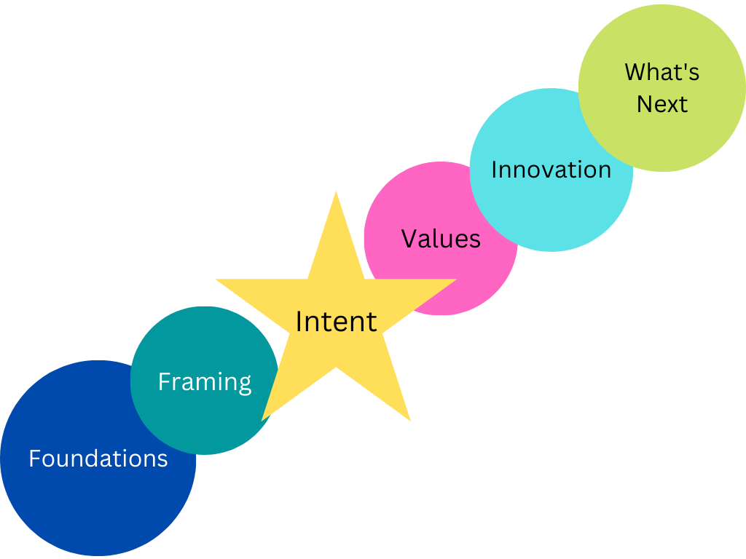
The arc of the work

Slide 9

Building the Foundation
Shared language
Relationship
Learning together
Notes:
The work of the subcommittee was built on the foundation established by the committee: issues, values and priorities that are essential to these discussions.
Shared language and understanding related to crisis standards of care, health equity and health justice.
Relationship development – building the container in which participants can surface different views, priorities and concerns. Skillful facilitation to support these conversations.
Learning together through essential presentations on key topics:
Health justice
Disadvantage indices
Foundational questions about allocation of scarce resources
Role of race correction in medicine
Community as system
Impact of the pandemic on community systems and health systems, and the people within them

Slide 10
Framing the Discussion
Preparing through reading
  Concerns about SOFA
  Using disadvantage indices in triage tools
Opening the conversation
  Questions and priorities
Expert support
Notes:
The subcommittee approached this process intentionally, supported by skillful facilitation and expert participation in the discussions.
The subcommittee reviewed different resources in advance of discussions, covering topics that included:
Concerns about SOFA
Use of disadvantage indices in triage tools
Based on the readings, subcommittee members shared their questions and ideas about what needed to be prioritized in their work.
Harald and Ruqaiijah supported the subcommittee's conversations, providing nuance, perspective and additional information to bolster the discussions.Alyshia facilitated the group to move through discussion to action.

Slide 11
Reading Materials Discussed
Oregon Interim Crisis Care Tool
University of Pittsburgh guidance on the allocation of scarce critical care resources
Rationing, racism and justice: advancing the debate around ‘colourblind’ COVID-19 ventilator allocation. Schmidt H, Roberts DE, Eneanya ND. J Med Ethics 2022; 48: 126-130.
The potential impact of triage protocols on racial disparities in clinical outcomes among COVID-positive patients in a large academic healthcare system. Roy S, et al. PLOS One 2021.
Racial disparities in the SOFA score among patients hospitalized with COVID-19. Tolchin B, et al. PLOS One 2021.

Slide 12
Intent
Will we worsen, maintain, or reduce health inequities through this approach?
Inflection point
Determine the intent of triage

Slide 13
Values and Principles
Shared understanding:
  Commonly used approaches do not align with our intent
Agreement on values and principles

Slide 14
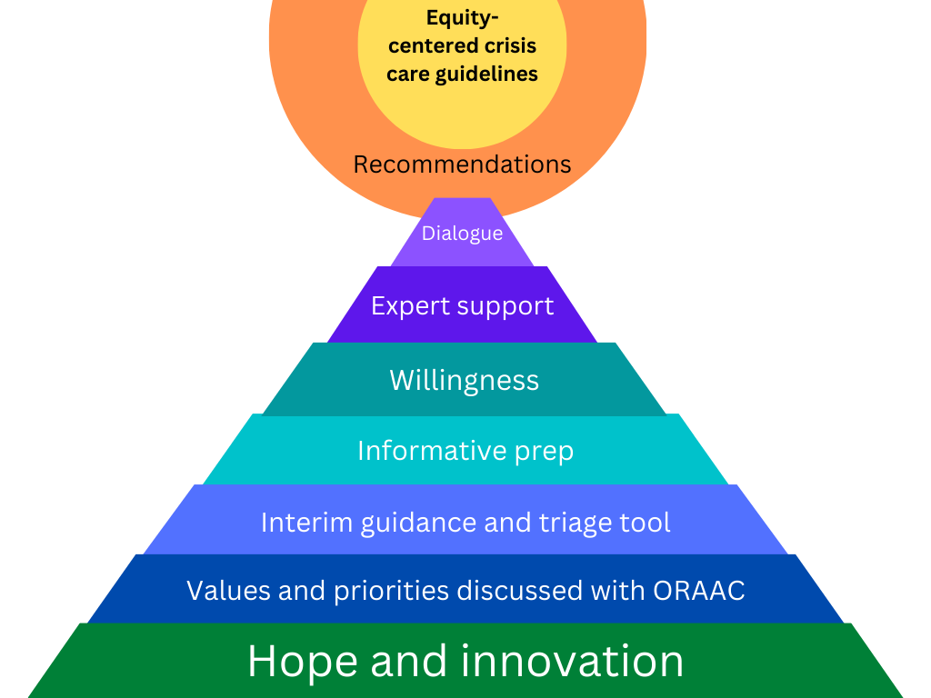
Hope and innovation are the foundation
Notes:
Hope and innovation are the bedrock on which the work is built. The subcommittee is willing to recognize that the tools and approaches broadly used now do not meet our purpose and we are willing to go outside the status quo to find a better way -- and believe that we can do it. We will not find a perfect solution out there. Hope and innovation are necessary!
This work is grounded in the values, priorities and issues discussed as a full ORAAC committee. All the preparation we did as a full committee in the summer and fall contributed to the readiness of the subcommittee to engage in this discussion from a place of shared understanding of the concerns inherent in the work.
The subcommittee
Informative prep – Resources that identified the issues and raised questions for discussion
Willingness – each subcommittee member’s ability to engage fully in the conversation and grapple with the issues
Expert support – from Alyshia, Harald and Ruqaiijah
Dialogue – sharing openly to uncover where we needed to dig deeper
This process supports the development of recommendations from the subcommittee for ORAAC to discuss, refine and approve.
Those recommendations will go to OHA to inform the next iteration of equity-centered crisis care guidelines.

Slide 15

What’s Next
Statements
Operationalize them
Turn into recommendations

Slide 16
Process Ahead
Present recommendations
Committee feedback
Community engagement
Public comment
Revised recommendations
Final recommendations

Slide 17
Draft Statements Disclaimer
Disclaimer: The draft statements to follow in this slide deck were intended for the purpose of generating subcommittee discussion and making progress towards recommendation development. These statements are not intended to represent the positions of the Triage Approaches Subcommittee, consultants or Oregon Health Authority staff.

Slide 18
Draft statements (1 of 9)
We will center hope and innovation in our work and not be limited but current practices or known options.

Slide 19
Draft statements (2 of 9)
We will work to achieve procedural justice through transparency, seeking community input on emerging recommendations, assessing local cultural values regarding resource allocation, considering this information as part of recommendation development and addressing concerns that arise. We will prioritize input from communities who face the greatest health inequities.

Slide 20
Draft statements (3 of 9)
The updated crisis care guidance must also acknowledge:
  That there is no perfect, universally accepted or accurate approach; justification will be needed for the choices made
  It will be necessary to continuously evaluate chosen approaches, review data, learn and refine guidance
  Health systems must develop ongoing partnerships with communities most impacted by oppression and health inequities to develop and refine crisis care guidelines and other approaches to reducing health inequities

Slide 21
Draft statements (3 of 9), continued
The updated crisis care guidance must also acknowledge:
  Crisis care tools are but one part of broader efforts needed in a public health emergency necessary to reduce inequities, including but not limited to: emergency preparedness; broad access to culturally responsive healthcare and basic needs; access to needed supports that allow individuals with disability to achieve desired independence and communicate their needs and goals; a diverse, responsive and supported healthcare workforce; local, regional, statewide and interstate communication and movement of patients to access needed care ( e.g., “load balancing”)

Slide 22
Draft statements (4 of 9)
The resource allocation methodology in crisis care guidelines is not adequate alone to reach our goal. Guidance must also outline the composition of the triage team that has decision-making responsibility . The expertise, diversity, role, training and support structures for the triage team are critical to attain the goal to reduce health inequities through resource allocation.

Slide 23
Draft statements (5 of 9)
We will prioritize health justice allocation factor(s) to achieve our goal.
Further exploration needed.

Slide 24
Draft statements (6 of 9)
We do not recommend using the Sequential Oregon Failure Assessment (SOFA) tool in resource allocation. The tool was developed to assess survivability for one condition (sepsis) and may not apply more broadly. Research shows this tool will exacerbate inequities which is unacceptable.

Slide 25
Draft statements (7 of 9)
We recommend against use of survivability as a primary factor in resource allocation. This approach is based on a utilitarian model which does not align with cross-cultural priorities. In addition, existing tools to assess survivability are known to or have the risk of exacerbating health inequities.

Slide 26
Draft statements (8 of 9)
Our task is to set out rules that guide who receives scarce, life-saving resources when there is not enough for everyone who needs them. In our approach to resource allocation, our goal is to reduce oppression, health inequities, and the disadvantage caused by these.

Slide 27
Draft statements (9 of 9)
We might consider likelihood of imminent death based on clinician prognostication as a factor in resource allocation.
(mixed support from subcommittee for this statement)

Slide 28
Next steps:
We will explore:
  Use of disadvantage indices as potential prioritization factors that address the intersectionality of disadvantage, including the possible following uses:
    As a primary allocation factor or tie breaker
    As a weighted lottery
  Other potential approaches to reduce health inequities

Slide 29
Process Ahead
Present recommendations
Committee feedback
Community engagement
Public comment
Revised recommendations
Final recommendations

Slide 30
Triage Team and Data

Slide 31
Triage Team and Data
We will not have a separate subcommittee focusing on these topics; we will incorporate the discussion into the full ORAAC committee meetings. Key topics for potential recommendation development include:
  Role, composition, responsibility of the triage team
  What data should be collected if resource allocation of life-saving care (e.g., critical care) is utilized

Slide 32
Oregon Interim Crisis Care Tool
Existing language: CSC triage team (1 of 4)
  A CSC triage team should be designated by the hospital for implementing critical care resource allocation determinations. Those serving as representatives of the triage team should not be caring for the patient being triaged, unless that is impossible given the staffing capabilities of the hospital. Triage staff must recuse themselves from triage determinations for patients they are personally treating unless no other option exists.

Slide 33
CSC triage team (2 of 4)
When possible, it is recommended that a hospital’s CSC triage team consist of:
Two to three senior clinicians with experience in triage (e.g., critical care, emergency medicine, trauma surgery, etc.). This should include at least one physician and one nurse. These clinicians should be licensed and actively participating in their field.
A medical ethicist with experience and training as a healthcare ethics consultant.
An expert in diversity, equity and inclusion.
An administrative assistant to record all triage team decisions and maintain necessary records and documents.

Slide 34
CSC triage team (3 of 4)
In order to best mitigate implicit bias, to the greatest extent possible each hospital should have a group of triage officers and a triage team that adequately reflects the diversity of the patient population served by the hospital in terms of demographics such as race, ethnicity, disability, preferred language, sexual orientation and gender identity.
Every attempt should be made to assemble a team that reflects the diversity of the community and population served by the hospital. Diversity among triage officers is intended to promote health equity and to mitigate against the perpetuation of health disparities in resource allocation.

Slide 35
CSC Triage Team (4 of 4)
Members of a hospital’s triage team with the responsibility to determine allocation of scarce resources should also have training in implicit bias and anti-racism. If staff with this training are not immediately available, such training for triage team members should be attained as soon as possible.

Slide 36
Data Collection and Transparent Communication
See OAR 333-505-0036 (Notice and Documentation of Triage Decisions)
Hospital Requirements During Emergency Impacting Standard of Care
OHA’s permanent rule OAR 333-505-0036 was effective January 24, 2023.

